Slide 1
Anatomy of NN

Slide 3
Outline
Anatomy of a NN
Design choices
Activation function
Loss function
Output units
Architecture

Slide 4
Outline
Anatomy of a NN
Design choices
Activation function
Loss function
Output units
Architecture

Slide 5
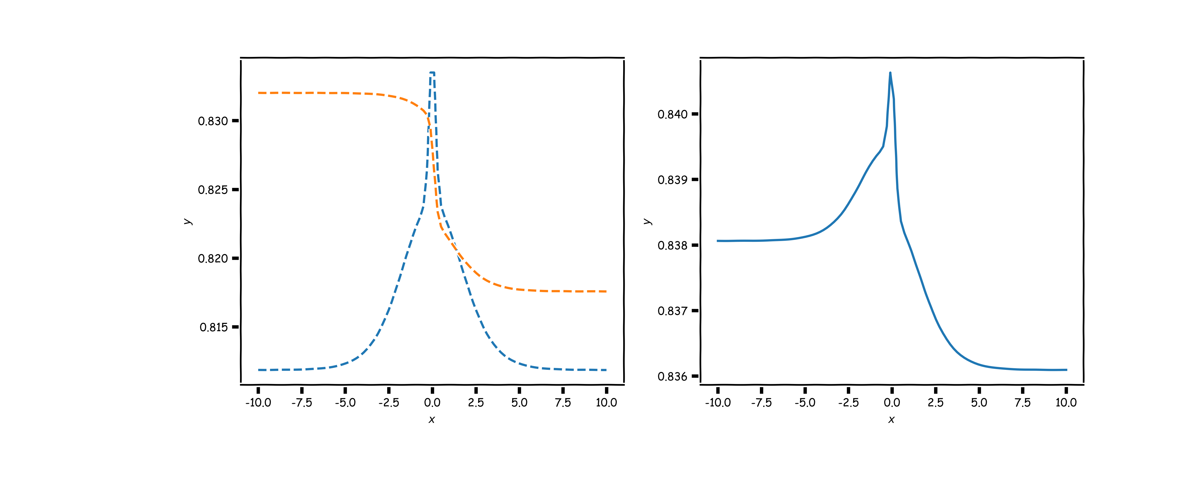
The central idea behind Neural Networks
Building a model that is both complex and simple to manipulate by composing multiple functions together.
Example:
X
Y

Slide 6
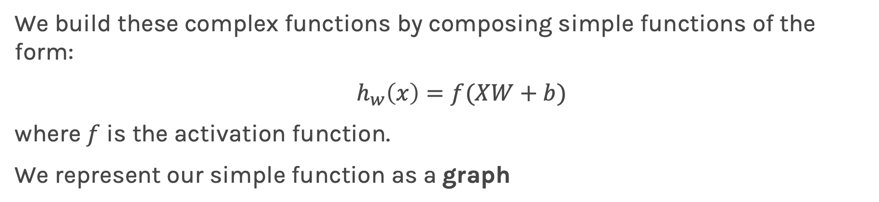
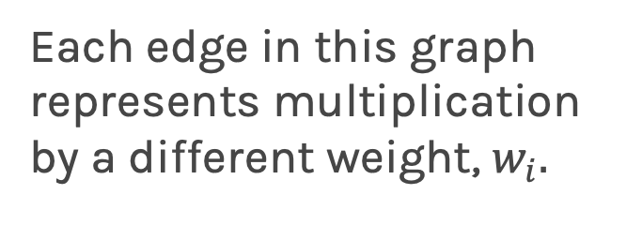
Graphical representation of simple functions
We build these complex functions by composing simple functions of the form:
$h_{w}\left(x\right)=f(XW+b)$
where $f$ is the activation function.
We represent our simple function as a graph
Each edge in this graph represents multiplication by a different weight, $w_{i}.$

Slide 7
The zoo of neural network architectures
Different architectures result into functions with very different properties.
Larger networks can express more complex functions

Slide 8
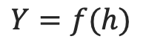
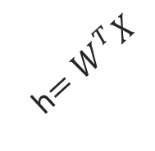
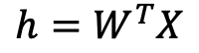
Anatomy of artificial neural network (ANN)
neuron
node
input
output
$$h=W^{T}X$$
Affine transformation
$$Y=f(h)$$
Activation
X
Y
h$=W^{T}X$
We will talk later about the choice of activation function. So far we have only talked about sigmoid as an activation function but there are other choices.

Slide 9
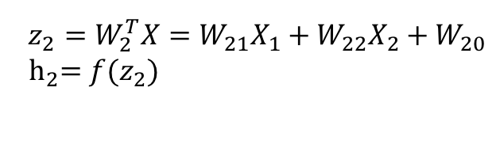

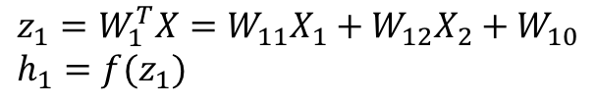
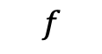
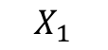
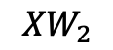
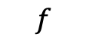
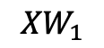
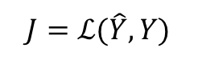
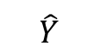
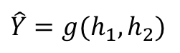
Anatomy of artificial neural network (ANN)
Input layer
hidden layer
output layer
$$z_{1}=W_{1}^{T}X=W_{11}X_{1}+W_{12}X_{2}+W_{10} \\ h_{1}=f(z_{1})$$
$$X_{1}$$
$${XW}_{1}$$
$$f$$
$$\hat{Y}$$
$$\hat{Y}=g(h_{1},h_{2})$$
$$J=ℒ(\hat{Y},Y)$$
Output function
Loss function
$$X_{2}$$
$${XW}_{2}$$
$$f$$
$$z_{2}=W_{2}^{T}X=W_{21}X_{1}+W_{22}X_{2}+W_{20}$$
$${ h}_{2}=f(z_{2})$$
We will talk later about the choice of the output layer and the loss function. So far we consider sigmoid as the output and log-bernouli.

Slide 10
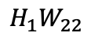
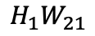
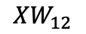
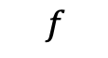
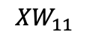
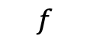
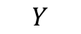
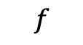
Anatomy of artificial neural network (ANN)
Input layer
hidden layer 1
hidden layer 2
output layer
$$X_{1}$$
$${XW}_{11}$$
$$f$$
$${H_{1}W}_{21}$$
$$f$$
$$Y$$
$$X_{2}$$
$${XW}_{12}$$
$$f$$
$${H_{1}W}_{22}$$
$$f$$

Slide 11
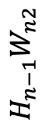
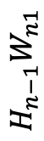
Anatomy of artificial neural network (ANN)
Input layer
hidden layer 1
hidden layer n
output layer
$$X_{1}$$
$${XW}_{11}$$
$$f$$
…
$$f$$
$${H_{n−1}W}_{n1}$$
$$Y$$
$$X_{2}$$
$${XW}_{12}$$
$$f$$
…
$$f$$
$${H_{n−1}W}_{n2}$$
We will talk later about the choice of the number of layers.

Slide 12
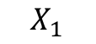
Anatomy of artificial neural network (ANN)
Input layer
hidden layer 1, 3 nodes
hidden layer n
3 nodes
output layer
$$X_{1}$$
…
$$Y$$
$$X_{2}$$

Slide 13
Anatomy of artificial neural network (ANN)
Input layer
hidden layer 1,
hidden layer n
output layer
m nodes
$$X_{1}$$
m nodes
…
…
$$Y$$
$$X_{2}$$
We will talk later about the choice of the number of nodes.

Slide 14
Anatomy of artificial neural network (ANN)
Input layer
hidden layer 1,
hidden layer n
output layer
m nodes
$$X_{1}$$
m nodes
Number of inputs d
…
…
$$Y$$
$$X_{2}$$
Number of inputs is specified by the data

Slide 15
Anatomy of artificial neural network (ANN)
input layer
output layer
hidden layer 1
hidden layer 2

Slide 16
Anatomy of artificial neural network (ANN)
input layer
output layer
hidden layer 1
hidden layer 2

Slide 17
Outline
Anatomy of a NN
Design choices
Activation function
Loss function
Output units
Architecture

Slide 18
Outline
Anatomy of a NN
Design choices
Activation function
Loss function
Output units
Architecture

Slide 19
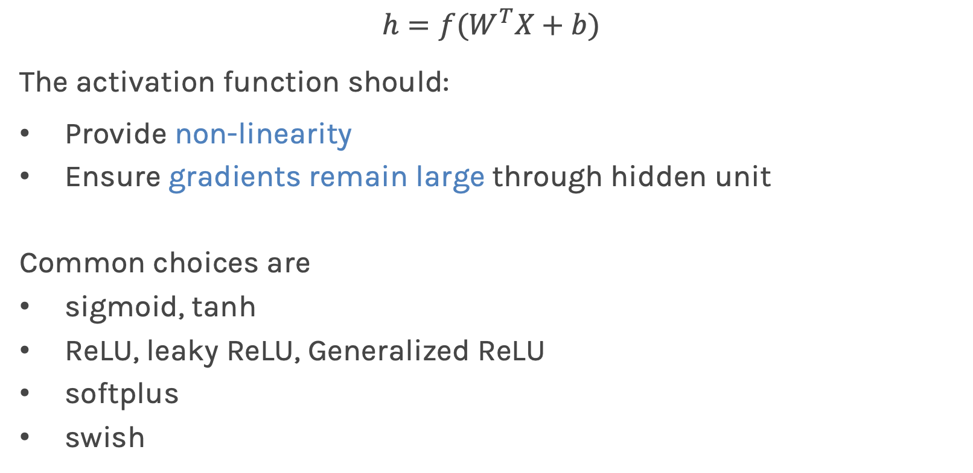
Activation function
$$h=f(W^{T}X+b)$$
The activation function should:
Provide non-linearity
Ensure gradients remain large through hidden unit
Common choices are
sigmoid, tanh
ReLU, leaky ReLU, Generalized ReLU
softplus
swish

Slide 20
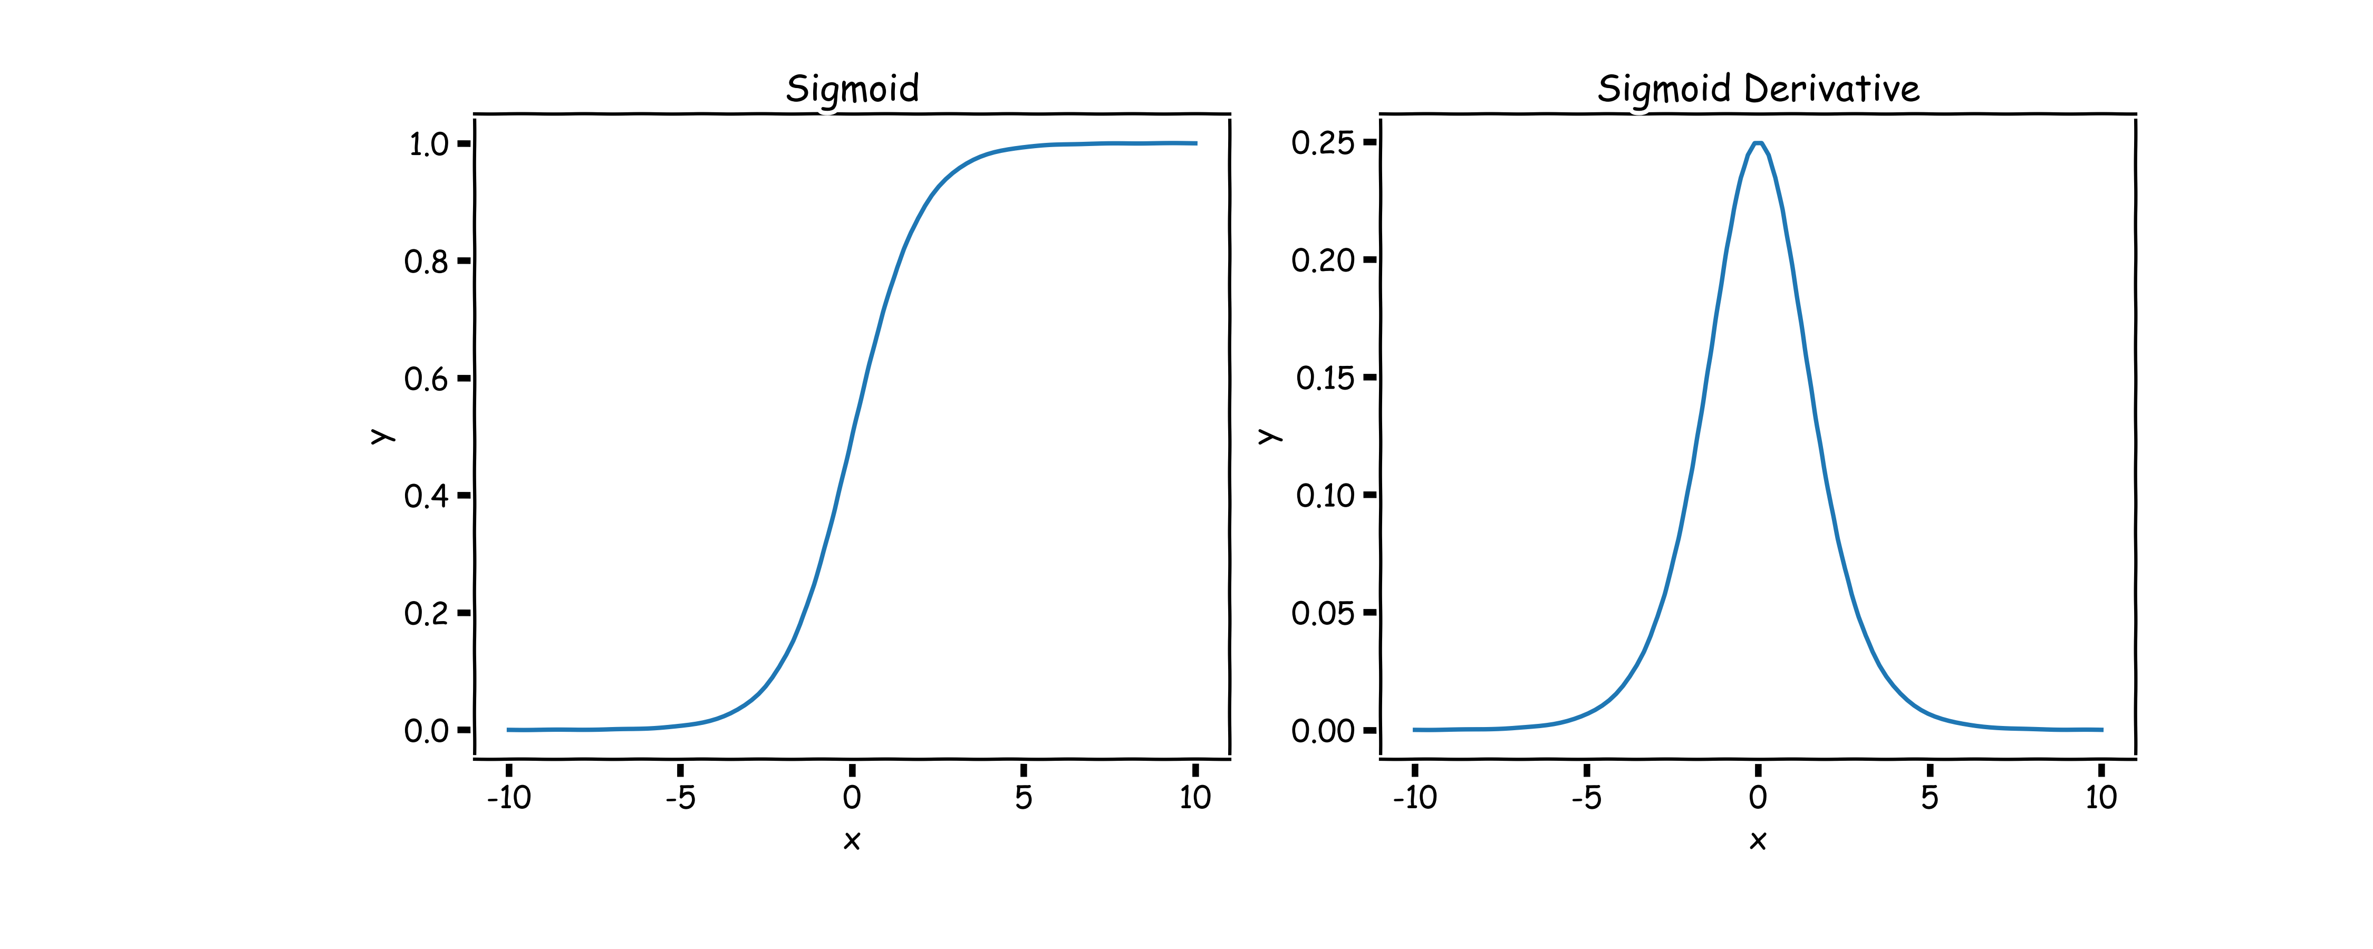
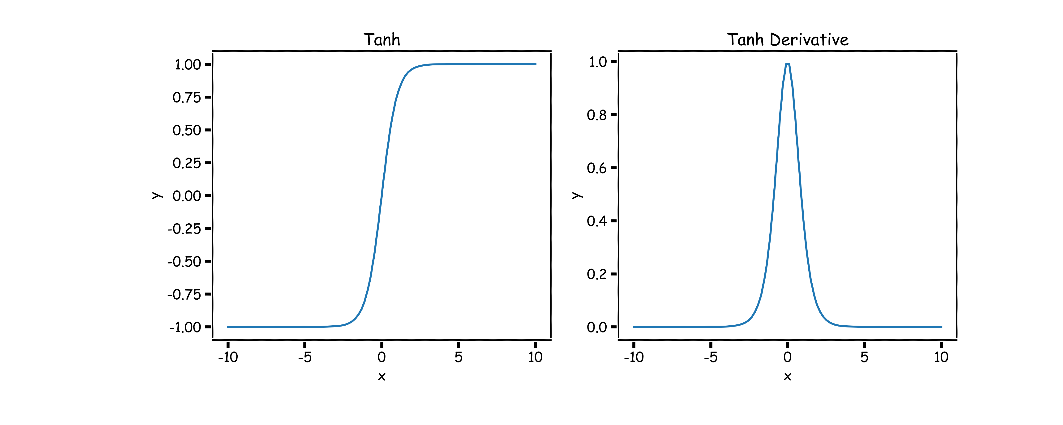
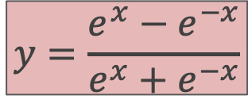
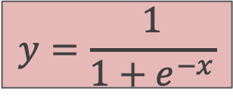
Sigmoid, $σ()$ (aka logistic) and tanh
$$y=\frac{1}{1+e^{−x}}$$
$$y=\frac{e^{x}−e^{−x}}{e^{x}+e^{−x}}$$
Derivative is zero for much of the domain. This leads to “vanishing gradients” in backpropagation.

Slide 21
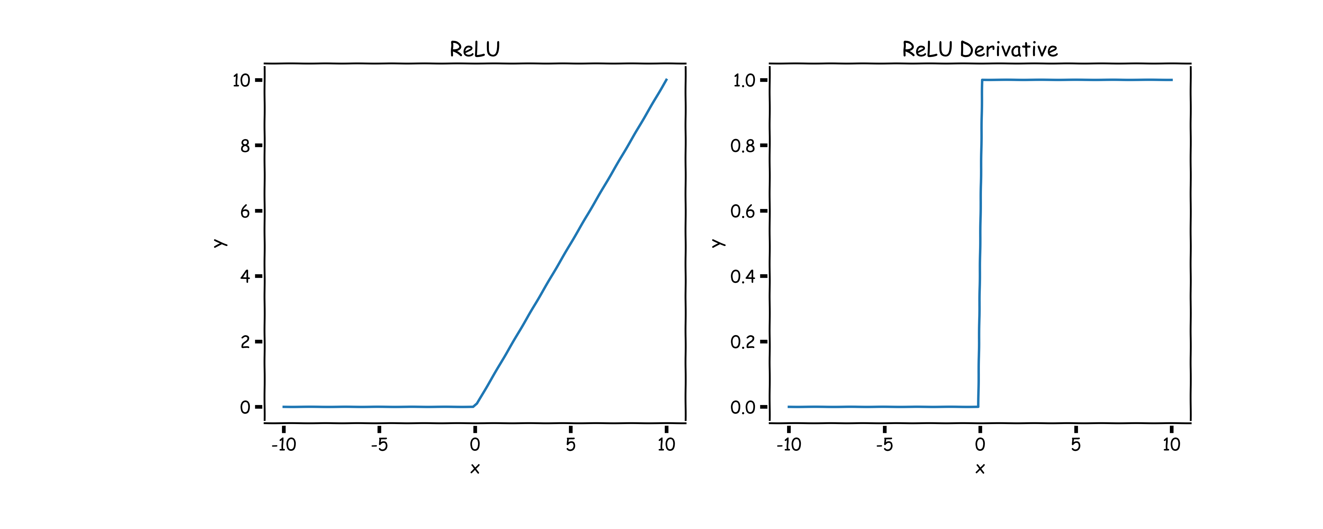
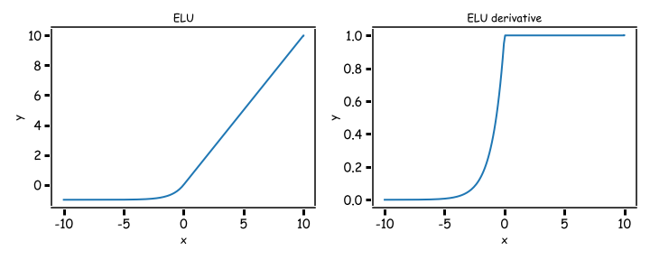
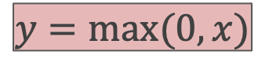
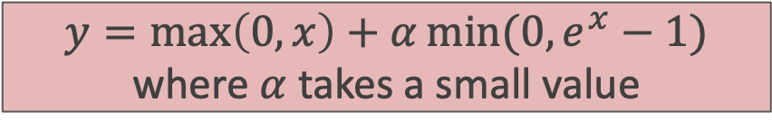
Rectified Linear Unit, ReLU(), Exponential ReLU (ELU)
$$y=\max\left(0,x\right)+α\min{(0,e^{x}−1)}$$
where $α$ takes a small value
$$y=max⁡(0,x)$$
Two major advantages:
No vanishing gradient when x > 0
Provides sparsity (regularization) since y = 0 when x < 0
No vanishing gradients and easy to calculate.

Slide 22
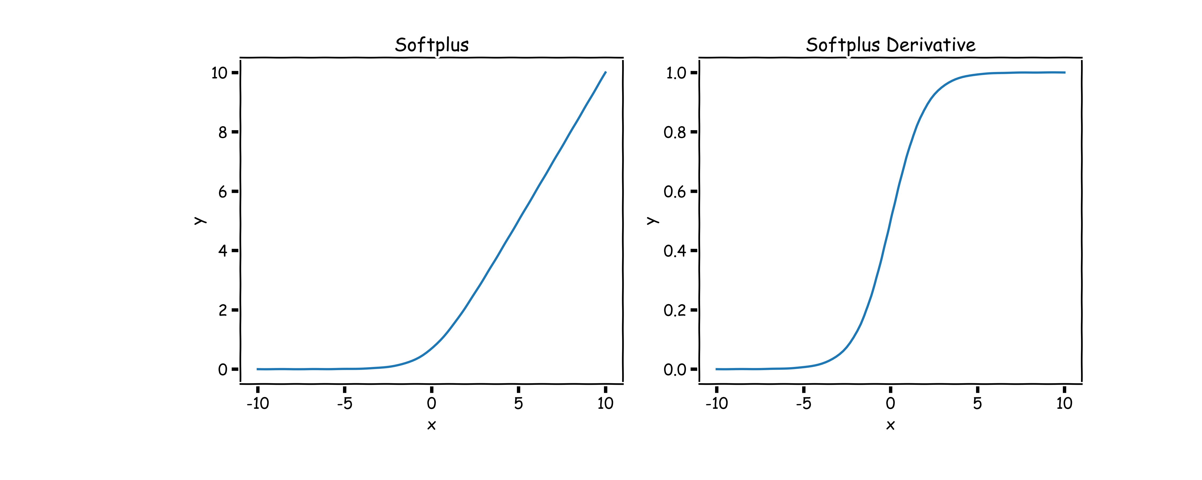
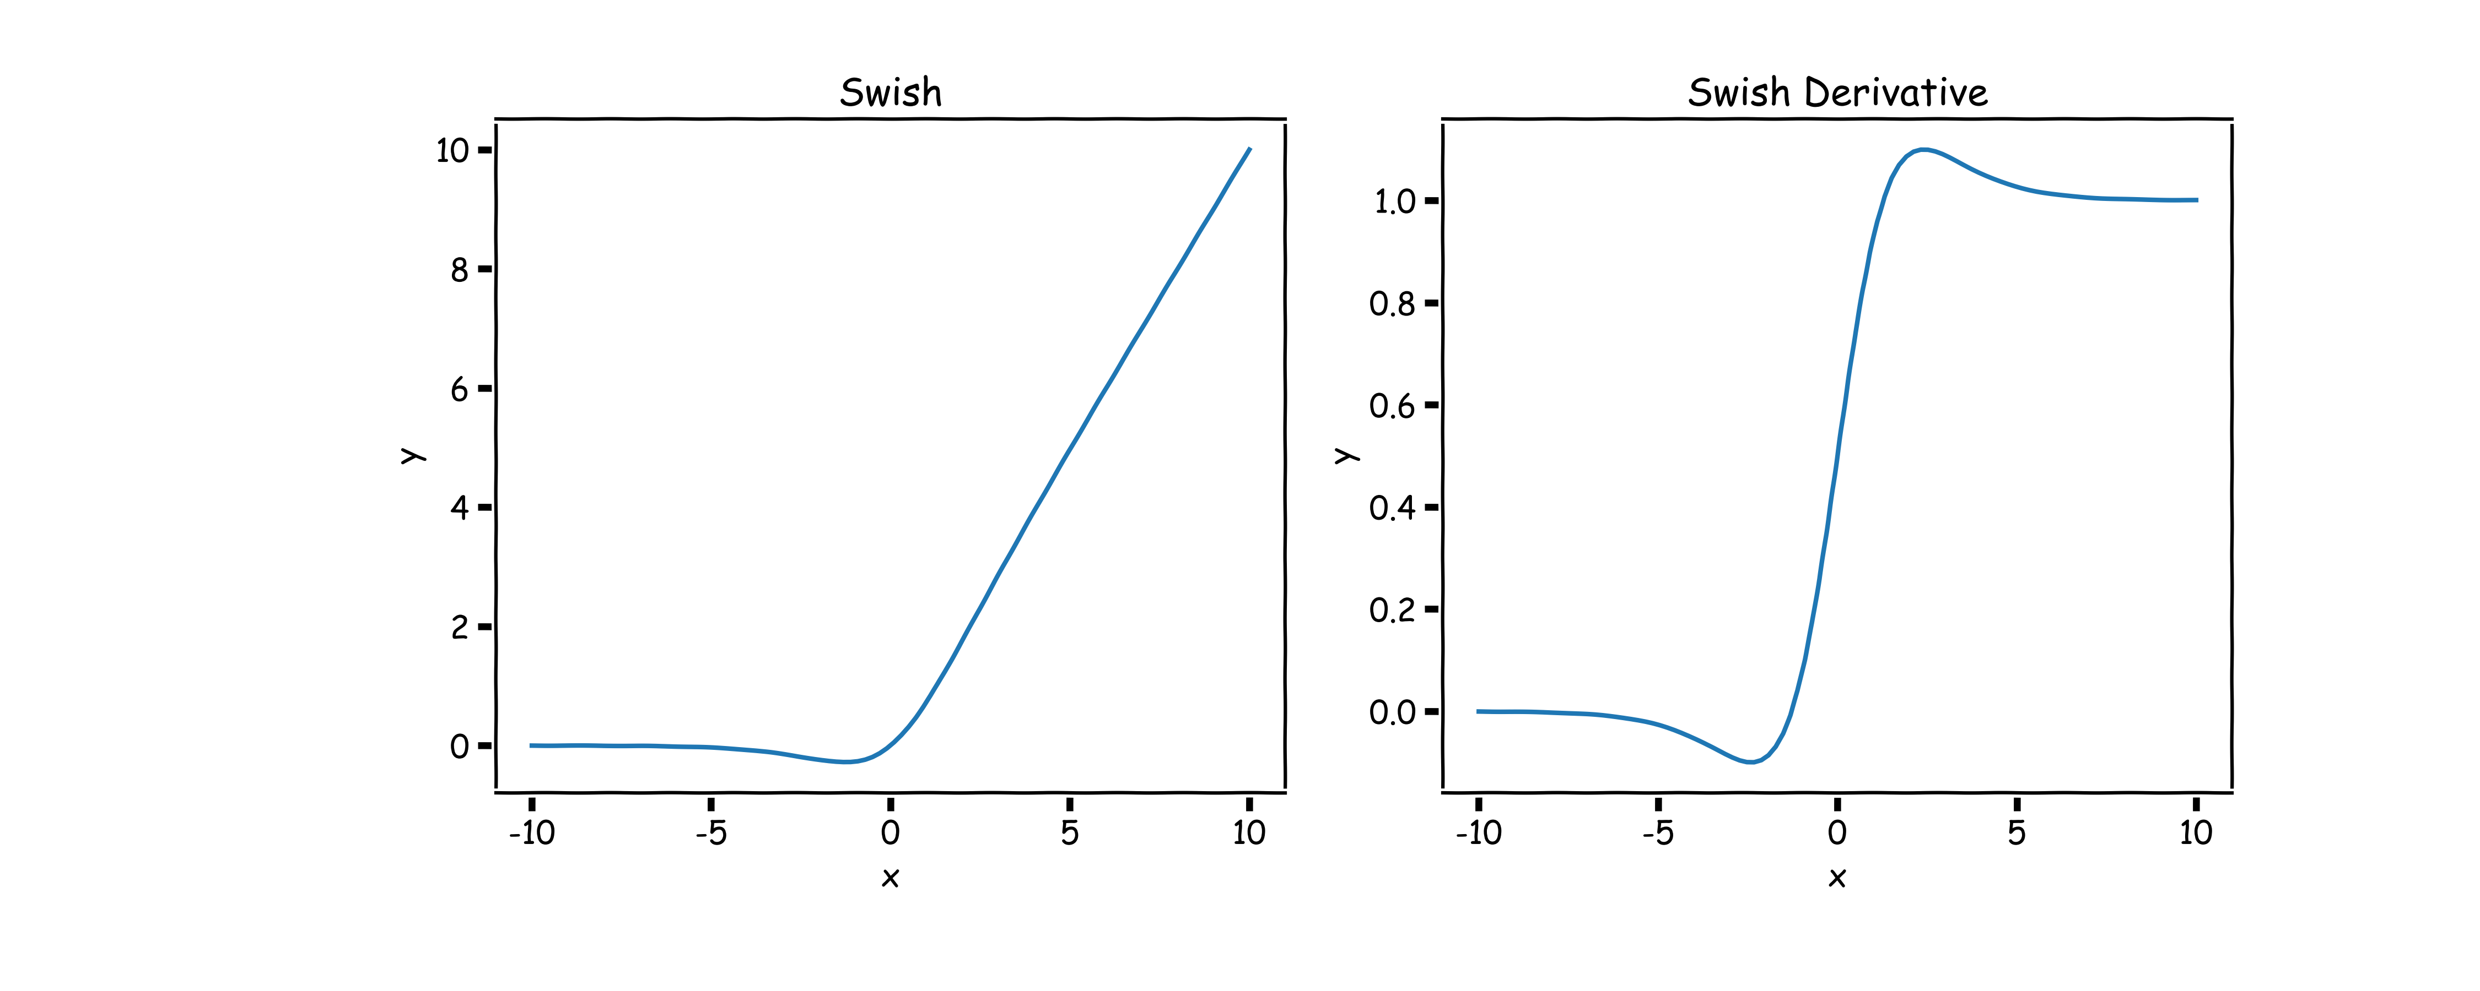
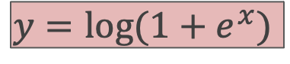
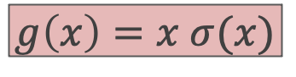
Softplus and Swish
$$y=\log{(1+e^{x})}$$
$$g\left(x\right)=x σ(x)$$
The derivative of the softplus is the sigmoid logistic function, which is a smooth approximation of the derivative of the rectifier. So the derivative of the softplus is continuous.
Swish tends to work better than ReLU on deeper models across a number of challenging datasets.

Slide 23
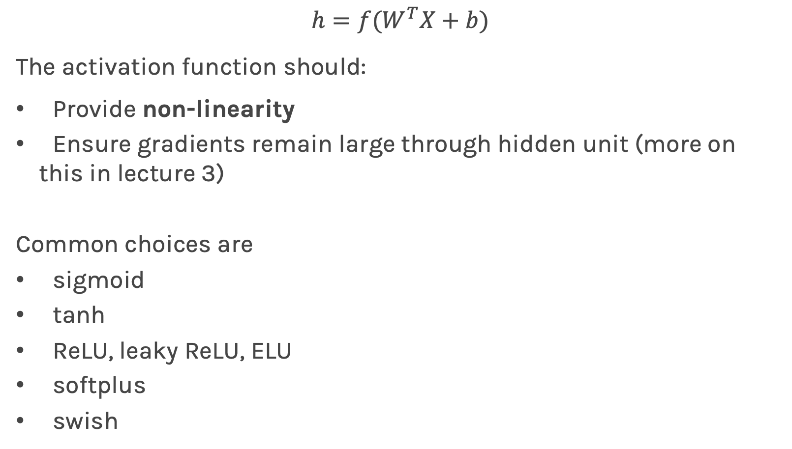
Activation function
$$h=f(W^{T}X+b)$$
The activation function should:
Provide non-linearity
Ensure gradients remain large through hidden unit (more on this in lecture 3)
Common choices are
sigmoid
tanh
ReLU, leaky ReLU, ELU
softplus
swish

Slide 24
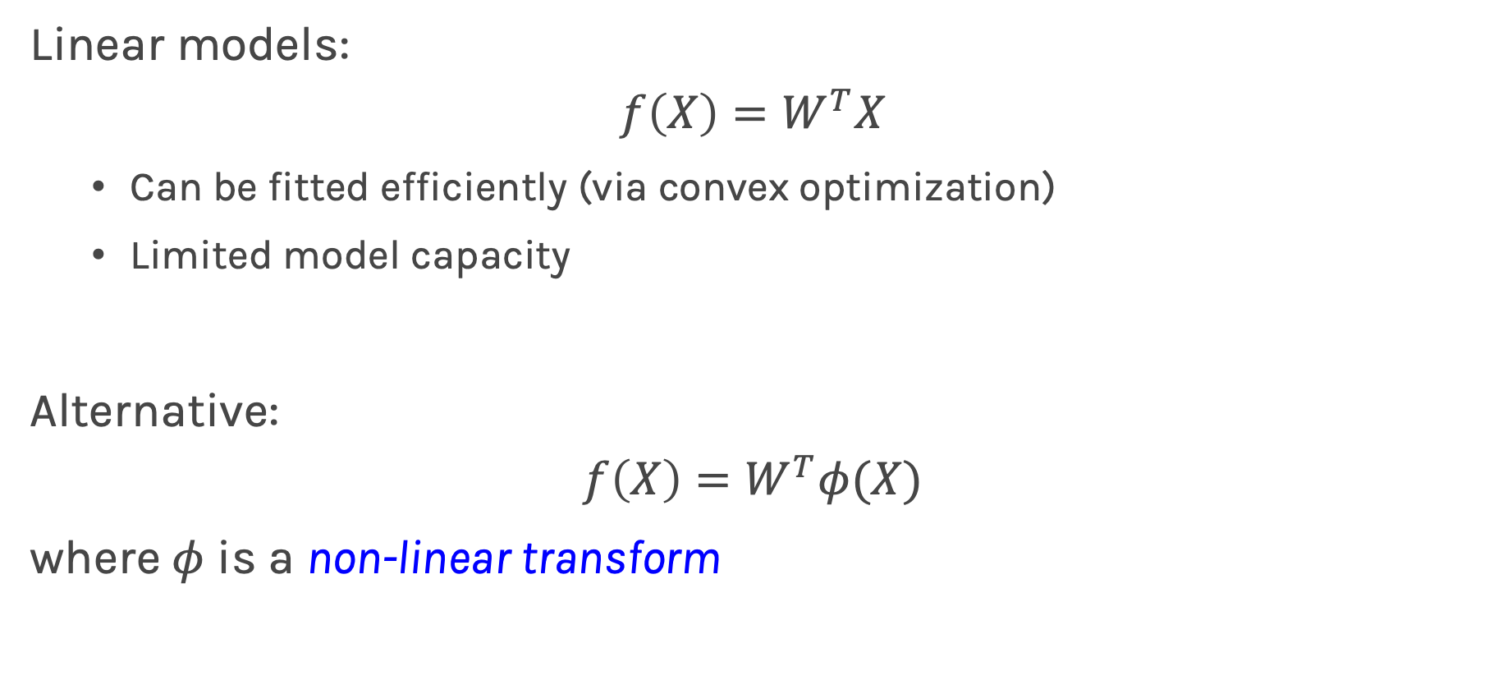
Beyond Linear Models
Linear models:
$$f\left(X\right)=W^{T}X$$
Can be fitted efficiently (via convex optimization)
Limited model capacity
Alternative:
$$f\left(X\right)=W^{T}φ(X)$$
where $φ$ is a non-linear transform

Slide 25
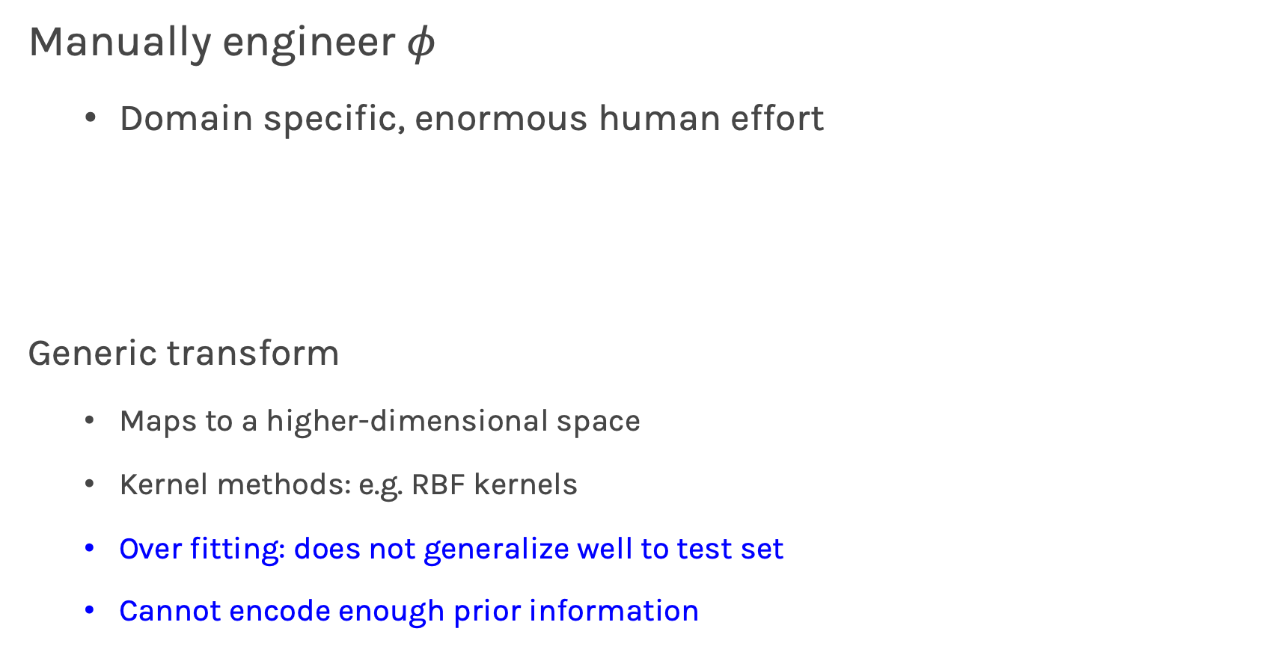
Traditional ML
Manually engineer $φ$
Domain specific, enormous human effort
Generic transform
Maps to a higher-dimensional space
Kernel methods: e.g. RBF kernels
Over fitting: does not generalize well to test set
Cannot encode enough prior information

Slide 26
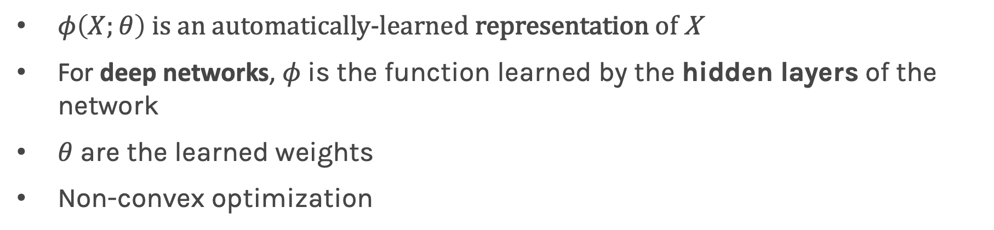
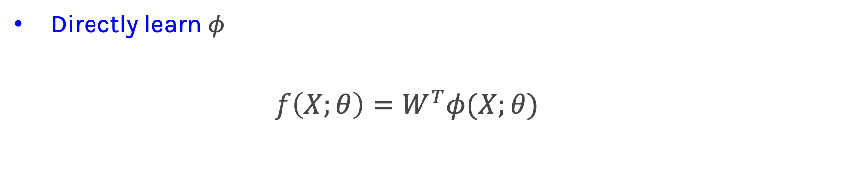
Deep Learning
Directly learn $φ$
$$f\left(X;θ\right)=W^{T}φ(X;θ)$$
$φ\left(X;θ\right)$ is an automatically-learned representation of X
For deep networks, $φ$is the function learned by the hidden layers of the network
$θ$ are the learned weights
Non-convex optimization

Slide 27
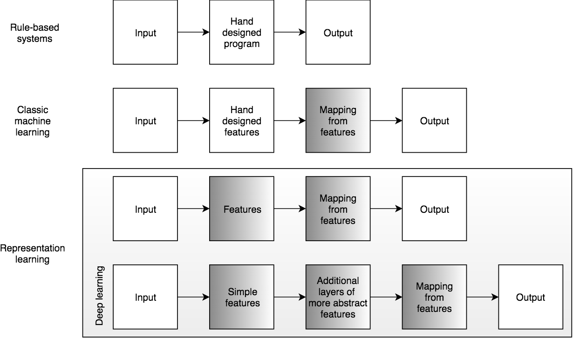
Learning Multiple Components

Slide 28
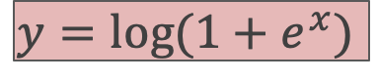
softplus
$$y=\log{(1+e^{x})}$$
The derivative of the softplus is the sigmoid logistic function, which is a smooth approximation of the derivative of the rectifier. So the derivative of the softplus is continuous.

Slide 29
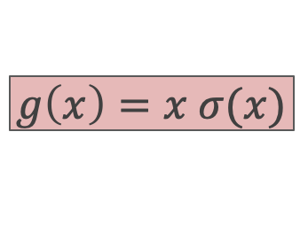
Swish: A Self-Gated Activation Function
$$g\left(x\right)=x σ(x)$$
Currently, the most successful and widely-used activation function is the ReLU. Swish tends to work better than ReLU on deeper models across a number of challenging datasets.

Slide 30
TL;DR (too long; didn’t read)
Use ReLU or leaky ReLU or ELU to start.
If you are concerned for a few points improvement in performance, experiment with swish and softplus and treat them as hyperparameters. In other words choose the activation that gives you the best validation loss.

Slide 31
Outline
Anatomy of a NN
Design choices
Activation function
Loss function
Output units
Architecture

Slide 32
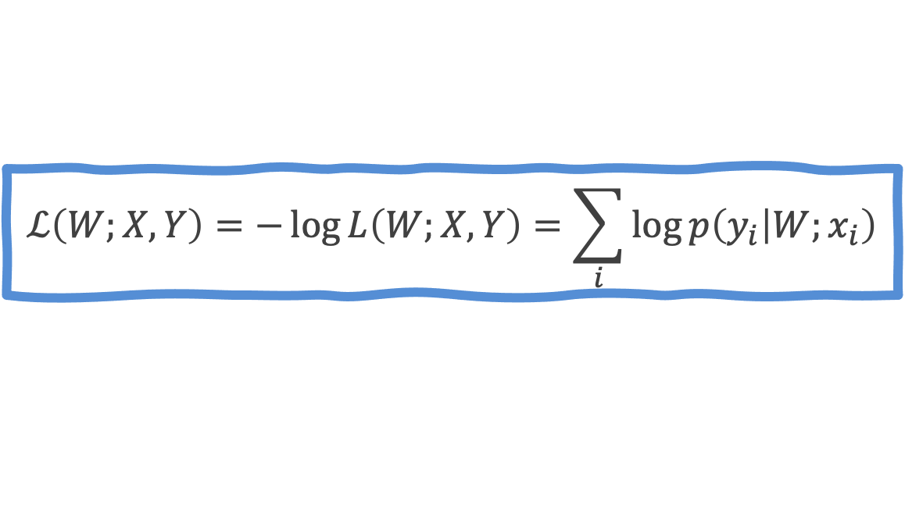
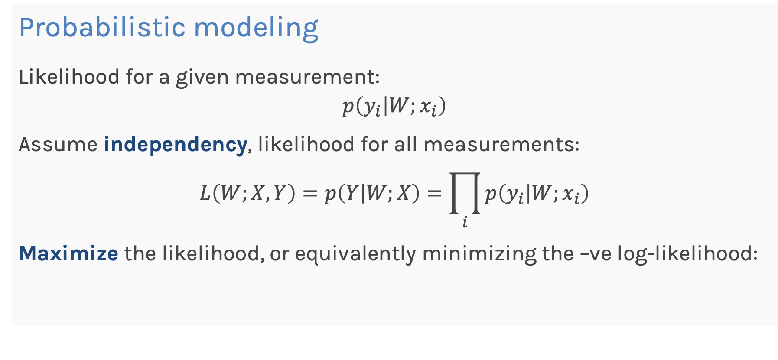
Loss Function
Probabilistic modeling
Likelihood for a given measurement:
$$p\left(y_{i} | W;x_{i}\right)$$
Assume independency, likelihood for all measurements:
$$L\left(W;X,Y\right)=p\left(Y | W;X\right)=\prod_{i}{p\left(y_{i} | W;x_{i}\right)}$$
Maximize the likelihood, or equivalently minimizing the –ve log-likelihood:
$$ℒ\left(W;X, Y\right)=−\log{L\left(W;X,Y\right)=\sum_{i}{\log{p\left(y_{i} | W;x_{i}\right)}}}$$

Slide 33

Loss Function
Do not need to design separate loss functions if we follow the probabilistic modeling approach, i.e. minimize the –ve likelihood function.
Examples:
Distribution is Normal then –ve log-likelihood is $MSE$:
$$p\left(y_{i} | W;x_{i}\right)=\frac{1}{√\left\{2π^{2}σ\right\}}e^{−\frac{{\left(y_{i}−{\hat{y}}_{i}\right)}^{2}}{2σ^{2}}}$$
$ℒ\left(W;X, Y\right)=\sum_{i}{{\left(y_{i}−{\hat{y}}_{i}\right)}^{2}}$
Distribution is Bernouli then –ve log-likelihood is Binary Cross-Entropy:
$$p\left(y_{i} | W;x_{i}\right)=p_{i}^{y_{i}}{\left(1−p_{i}\right)}^{1−y_{i}}$$
$ℒ\left(W;X, Y\right)=−\sum_{i}{\left[y_{i}\log{p_{i}}+{(1−y}_{i})\log{(1−p_{i})}\right] }$

Slide 34

Loss Function
For y that follow Multinouli, then likelihood is:
$$p\left(y_{i} | W;x_{i}\right)=\prod_{k}{p}{\left(y_{i}=k\right)}^{𝕀(y_{i}=k)}$$
$ℒ\left(W;X, Y\right)=−\sum_{i}{\sum_{k}{𝕀\left(y_{i}=k\right)\log{p(y_{i}=k)} }}$
where k is the class and $𝕀(y_{i}=k$) is the indicator function.
Questions:
How do we know what distribution to use?
Why not MSE for classification?
Cross-Entropy

Slide 35



Loss Function
Example: sigmoid output + squared loss
$$L_{sq}={\left(y−\hat{y}\right)}^{2}={\left(y−σ\left(x\right)\right)}^{2}$$
Flat surfaces

Slide 36



Loss Function
Saturates only when the model makes correct predictions
Example: sigmoid output + cross-entropy loss
$$L_{ce}\left(y,\hat{y}\right)=−\{ y\log{\hat{y}+\left(1−y\right)\log{(1−\hat{y})\}}}$$

Slide 37
Design Choices
Activation function
Loss function
Output units
Architecture
Optimizer

Slide 38
Output Units
Output Type | Output Distribution | Output layer | Loss Function
Binary | Bernoulli | ? | Binary Cross Entropy

Slide 39





Output unit for binary classification
X
$$\hat{Y}=P(y=1)$$
OUTPUT UNIT
X
$$φ\left(X\right)$$
$$σ(φ(X))$$
$$\hat{Y}=P(y=1)$$
$$X⟹φ\left(X\right)⟹P\left(y=1\right)=\frac{1}{1+e^{−φ(X)}}$$

Slide 40
Output Units
Output Type | Output Distribution | Output layer | Cost Function
Binary | Bernoulli | Sigmoid | Binary Cross Entropy

Slide 41
Output Units
Output Type | Output Distribution | Output layer | Cost Function
Binary | Bernoulli | Sigmoid | Binary Cross Entropy
Discrete

Slide 42
Output Units
Output Type | Output Distribution | Output layer | Cost Function
Binary | Bernoulli | Sigmoid | Binary Cross Entropy
Discrete | Multinouli

Slide 43
Output Units
Output Type | Output Distribution | Output layer | Loss Function
Binary | Bernoulli | Sigmoid | Binary Cross Entropy
Discrete | Multinouli |  | Cross Entropy

Slide 44
Output Units
Output Type | Output Distribution | Output layer | Cost Function
Binary | Bernoulli | Sigmoid | Binary Cross Entropy
Discrete | Multinouli | ? | Cross Entropy

Slide 45

Output unit for multi-class classification
X
$$\hat{Y}=[P_{1},P_{2},P_{3}]$$
OUTPUT UNIT

Slide 46



SoftMax
$$\hat{Y}=\frac{e^{φ_{k}\left(X\right)}}{\sum_{k=1}^{K}{e^{φ_{k}\left(X\right)}}}$$
$$φ_{k}\left(X\right)$$
$$0≤A,B, C≤1$$
$$A+B+C=1$$
A score
Probability of A
rest of the network
B score
Probability of B
C score
Probability of C
OUTPUT UNIT

Slide 47


SoftMax
$$\hat{Y}=\frac{e^{φ_{k}\left(X\right)}}{\sum_{k=1}^{K}{e^{φ_{k}\left(X\right)}}}$$
$$φ_{k}\left(X\right)$$
A score
Probability of A
rest of the network
B score
SoftMax
Probability of B
C score
Probability of C
OUTPUT UNIT

Slide 48

SoftMax
$$\hat{Y}=\frac{e^{φ_{k}\left(X\right)}}{\sum_{k=1}^{K}{e^{φ_{k}\left(X\right)}}}$$
$$φ_{k}\left(X\right)$$
Probability of A
rest of the network
SoftMax
Probability of B
Probability of C
OUTPUT UNIT

Slide 49
Output Units
Output Type | Output Distribution | Output layer | Cost Function
Binary | Bernoulli | Sigmoid | Binary Cross Entropy
Discrete | Multinoulli | Softmax | Cross Entropy

Slide 50
Output Units
Output Type | Output Distribution | Output layer | Cost Function
Binary | Bernoulli | Sigmoid | Binary Cross Entropy
Discrete | Multinoulli | Softmax | Cross Entropy
Continuous

Slide 51
Output Units
Output Type | Output Distribution | Output layer | Cost Function
Binary | Bernoulli | Sigmoid | Binary Cross Entropy
Discrete | Multinoulli | Softmax | Cross Entropy
Continuous | Gaussian

Slide 52
Output Units
Output Type | Output Distribution | Output layer | Cost Function
Binary | Bernoulli | Sigmoid | Binary Cross Entropy
Discrete | Multinoulli | Softmax | Cross Entropy
Continuous | Gaussian |  | MSE

Slide 53
Output Units
Output Type | Output Distribution | Output layer | Cost Function
Binary | Bernoulli | Sigmoid | Binary Cross Entropy
Discrete | Multinoulli | Softmax | Cross Entropy
Continuous | Gaussian | ? | MSE

Slide 54




Output unit for regression
X
$$\hat{Y}$$
OUTPUT UNIT
X
$$φ\left(X\right)$$
$$W^{T}φ(X)$$
$$\hat{Y}$$
$$X⟹φ\left(X\right)⟹\hat{Y}=W^{T}φ(X)$$

Slide 55
Output Units
Output Type | Output Distribution | Output layer | Cost Function
Binary | Bernoulli | Sigmoid | Binary Cross Entropy
Discrete | Multinoulli | Softmax | Cross Entropy
Continuous | Gaussian | Linear | MSE

Slide 56
Output Units
Output Type | Output Distribution | Output layer | Cost Function
Binary | Bernoulli | Sigmoid | Binary Cross Entropy
Discrete | Multinoulli | Softmax | Cross Entropy
Continuous | Gaussian | Linear | MSE
Continuous | Arbitrary | -

Slide 57
Output Units
Output Type | Output Distribution | Output layer | Cost Function
Binary | Bernoulli | Sigmoid | Binary Cross Entropy
Discrete | Multinoulli | Softmax | Cross Entropy
Continuous | Gaussian | Linear | MSE
Continuous | Arbitrary | - | GANS

Slide 58
Constructing an MLP with Keras

